Slide 1
Finding a percentage with a multiplier
Task A: Reviewing percentages of amounts
Work out:
a) 51% of 980 =
b) 23% of 640 =
c) 62% of 120 =
d) 13% of 140 =
e) 3% of 40 =
f) 9% of 24 =
Task B: Using a decimal multiplier
Write the calculation showing the decimal multiplier.
You do not need to calculate the answer.
a) 56% of 389
b) 24% of 484
c) 16% of 563.1
d) 3% of 186.2
e) 33.3% of 475
f) 3.3% of 986

Slide 2
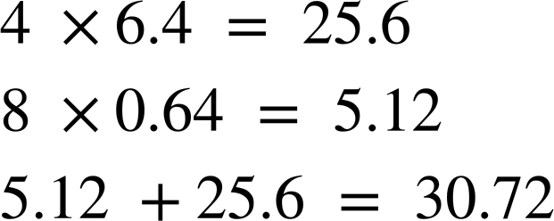
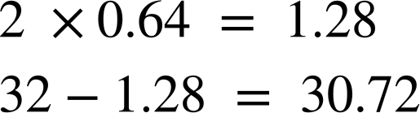
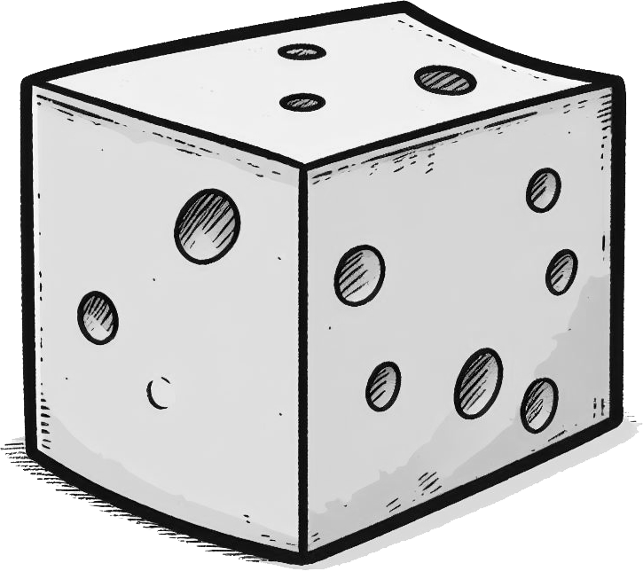
Finding a percentage with a multiplier
2) Work out:
a) 27% of 560
b) 18% of 244
c) 6% of 94
3) Can you explain the strategy behind each student’s working out for finding 48% of 64?
Alex
Sam
4) A hard cheddar cheese contains 37% water, 33% fat, 23% protein, 3.5% carbohydrates, and 3.5% minerals and other compounds.
From a 250g block of cheese, work out how many grams there are of:
Water
Fat
Protein
Mathematics in Education and Industry.
v2.3

